Slide 1

Planning and Stakeholder
Relations Committee
January 17, 2020
Planning and Stakeholder Relations Committee – January 2020

Slide 2
Agency Tactical Plan Update
Planning and Stakeholder Relations Committee – January 2020

Slide 3
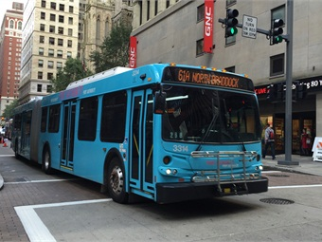
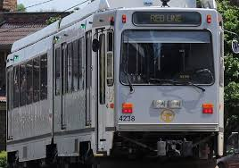

Agency Tactical Plan Update
Staff Kick-Off Event – September 2018
Five Key Areas with Executive Sponsors
  Customer Experience – D. Huffaker (Oct. 2019)
  Safety Program – M. Cetra (Oct. 2019)
  Financial Sustainability – P. Schenk (Nov. 2019)
  Customer and Stakeholder Engagement – J. Ritchie
  Employee Engagement – I. Colon
Staff Close-Out Event – December 2019
December 2019 to January 2020 – Shift to Strategic
Plan Development
Planning and Stakeholder Relations Committee – January 2020

Slide 4
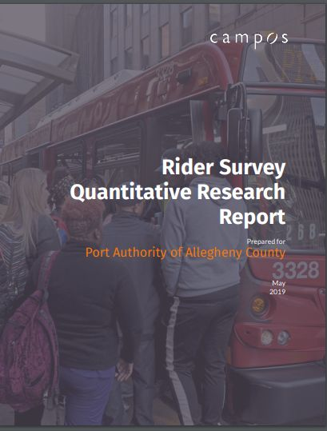
Customer and Stakeholder Engagement
Branding
Marketing focal point
Perception research
Now: developing potential brand concepts
Next: Review with board and public
Next: Implementation plan
Later: Integrated marketing plan
Planning and Stakeholder Relations Committee – January 2020

Slide 5
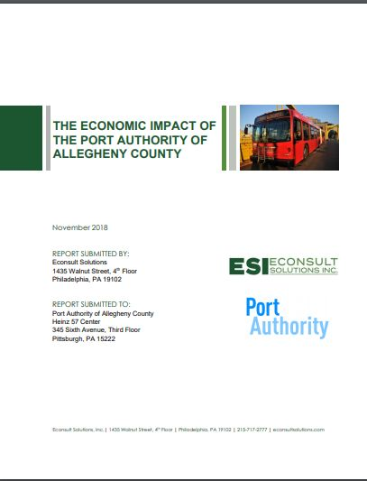
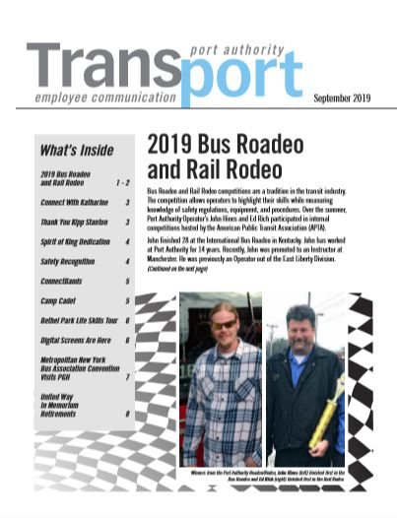
Customer and Stakeholder Engagement
Integrate Public Message
Key item – economic impact study
Employee Engagement
Employee newsletter

Slide 6
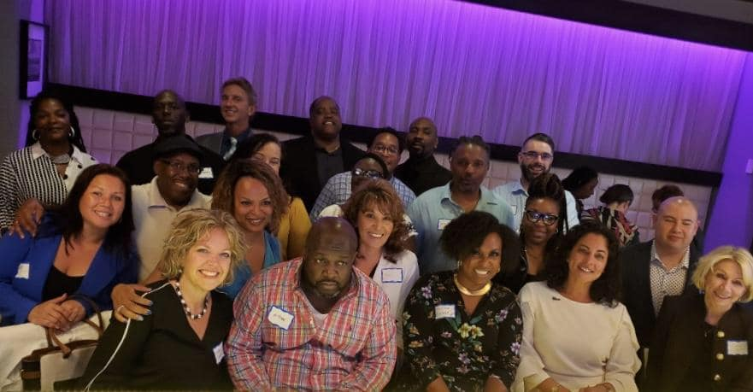
Customer and Stakeholder Engagement
Community Involvement
New process developed by Deb Skillings for special events.
Melissa Girty has developed a speakers bureau due to be launched in March/April.
Reboot relationships
Reconnected with municipal level leaders.
Connections with community-based nonprofits.
COMTO
Chapter is active.

Slide 7

Employee Engagement
Set a baseline for engagement and acknowledgement
  Compensation Desk Audit – Completed April 2019
  Employee Engagement Survey - Completed; results available February 2020
  Implemented PeopleSoft Employee Self Service
Planning and Stakeholder Relations Committee – January 2020

Slide 8

Employee Engagement
Focus on employee wellness, fitness and well-being
  Expand on the fitness room survey to all locations - Completed
  Encourage employee wellness through financial incentives – On-going
  Encourage use of the internal Employee Assistance Program (EAP)
    Establish EAP availability 24/7 – Completed April 2019
  Enhance employee financial wellness by offering a Roth 401(a) contribution program – In progress
Planning and Stakeholder Relations Committee – January 2020

Slide 9
Employee Engagement
Begin Port Authority University Concept
  Consolidate Operations training under one umbrella entitled “Port
    Authority Operations University” – In progress
  Initiate a succession plan for key positions – Relaunched in 2019
  Promote and encourage staff to continue learning/training and use that
  knowledge internally – On-going
  Increase and improve management training programs for new, existing
  and high-potential management candidates – On-going
Labor Relations
  300 Committee – In progress
  Open Door forums and other committees – On-going
Planning and Stakeholder Relations Committee – January 2020

Slide 10

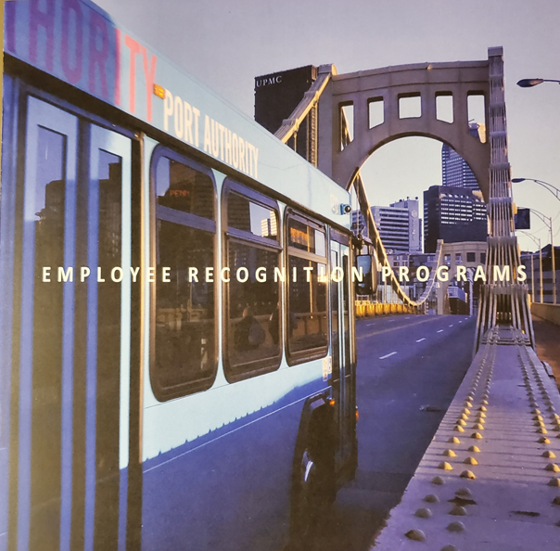
Develop employee recognition programs
Annual Event Calendar on Crossroads
Develop appreciation events
          Perfect Attendance
          Safety
          Commendations
        Years of Service – 1st year, then every 5th year of employment
Planning and Stakeholder Relations Committee – January 2020

Slide 11
General Planning Update
Planning and Stakeholder Relations Committee – January 2020

Slide 12
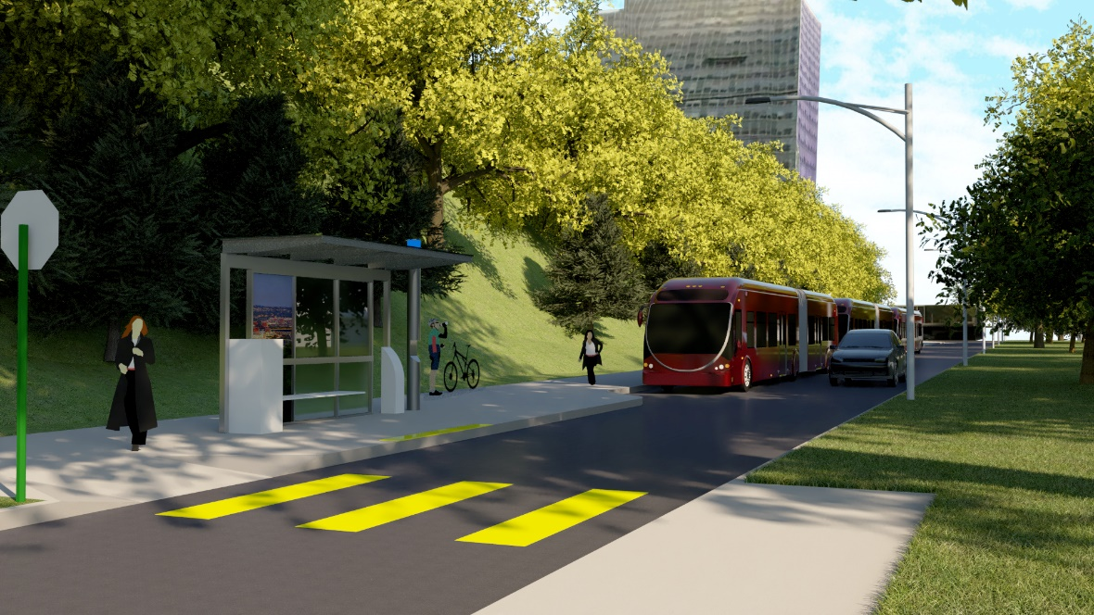
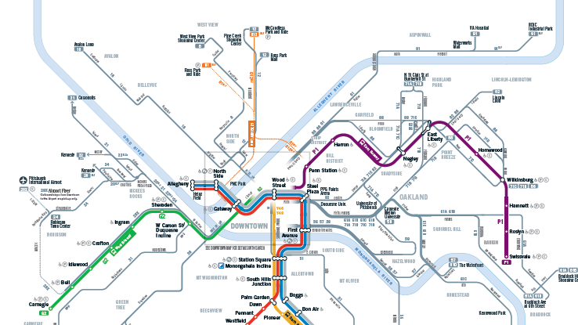
Planning Updates
Bus Stop Consolidation
Long Range Plan
Bus Rapid Transit

Slide 13
Community Outreach Update
Planning and Stakeholder Relations Committee – January 2020

Slide 14
Community Outreach Update
Public Transit: A Community Discussion
David L. Lawrence Convention Center, Downtown (three sessions)
Kingsley Association, East Liberty
Millvale Community Center
The Monroeville Convention Center Ballroom
The McKeesport Palisades
Pittsburgh Technical College, Oakdale
Bethel Park Community Center
Springdale Veterans Association
University of Pittsburgh, Oakland
What are the meetings for?
Topics include long range planning, service planning, BRT, fare policy and mobile app technology.
Annual engagement process
First meeting is Jan. 29 in Downtown
Web: portauthority.org/GetTogether
Planning and Stakeholder Relations Committee – January 2020

Slide 15
Mission
To Connect People to Life
Vision
To Become America’s Premier
Public Transportation Company

