Slide 1

Finance Committee
January 17, 2020
Finance Committee – January 2020

Slide 2
Operating and Capital
Grants Overview
Finance Committee – January 2020

Slide 3

Introduction to Sources of Port Authority
Grant Funding
Federal 5307- Urban Area Formula
  Supports Operating Budget via Capital Cost of Contracting, 80% of Rail and Bus Preventive Maintenance Expenses and 80% of Capital Cost of Contracting (ACCESS) Expenses.
  Supports a portion of annual bus purchase in FY2020 Capital Budget totaling $13.4 million.
    Source of funding is through UZA sub-allocation process.
    Eligible Expenses include: planning, engineering, design and evaluation of transit projects and other technical transportation-related studies; capital investments in bus and bus-related activities such as replacement, overhaul and rebuilding of buses, construction of maintenance and passenger facilities; and capital investments in new and existing fixed guideway systems including rolling stock, overhaul and rebuilding of equipment. All preventive maintenance and some Americans with Disabilities Act complementary paratransit service costs are considered capital costs.
Finance Committee – January 2020

Slide 4
Introduction to Sources of Port Authority
Grant Funding
Federal 5339- Bus and Bus Facilities
  Supports a portion of annual for bus purchases in FY2020 Capital Budget $5.36 million.
  The 5339 Grants for Buses and Bus Facilities program makes Federal resources available to States and designated recipients to replace, rehabilitate and purchase buses and related equipment and to construct bus-related facilities including technological changes or innovations to modify low or no emission vehicles or facilities. Funding is provided through formula allocations and competitive grants. A sub-program provides competitive grants for bus and bus facility projects that support low and zero-emission vehicles.
Program Component | FY2015 MAP-21 | FY2016 (in millions) | FY2017 (in millions) | FY2018 (in millions) | FY2019 (in millions) | FY2020 (in millions)
Formula | $427.80 | $427.80 | $436.36 | $445.52 | $454.96 | $464.61
Bus Discretionary | N/A | $213.00 | $228.60 | $246.51 | $267.06 | $289.04
Low & No Emissions Discretionary | N/A | $55.0 | $55.0 | $55.0 | $55.0 | $55.0
Total 5339 | $427.8 | $695.80 | $719.96 | $747.03 | $777.02 | $808.65
Finance Committee – January 2020

Slide 5
Introduction to Sources of Port Authority
Grant Funding
Federal 5307- Flex Funds
  Supports a portion of annual bus purchase in FY2020 Capital Budget totaling $6.17 million.
Transit Security Grant-The Transit Security Grant Program (TSGP) provides funds to eligible publicly owned operators of public transportation systems. Source of funding originates with the Department of Homeland Security.
  Funds can be used toward training or equipment that enhances National Preparedness.
  The Authority has been approved for $723,800 in Transit Security Grant Funding which is included in Capital Budget and will be used for CCTV’s.
State Act 89 Capital Funding- Source of funding is State discretionary capital funding originating from the Pennsylvania Turnpike. Under normal circumstances, the total annual amount is approximately $115.0 per year. Funding supports the majority of non-bus capital projects and debt service payments.
State Act 89 Operating Budget Funding- totals $239.3 in FY2020.
  Funds help support all bus and rail service and administrative activities.
Finance Committee – January 2020

Slide 6
Introduction to Sources of Port Authority
Grant Funding
Allegheny County Operating and Capital Match- The County has a required 15% match of State Act 89 Operating Assistance that totals $32.9 million in FY2020.
Allegheny County matches various percentages on Capital projects depending on Federal grant requirements. This totals $11.9 million in FY2020.
Regional Asset District Grant- Supports Bus and Rail Operations activities.
  $3.0 million annual allotment in the Operating Budget. The Authority must apply on an annual basis for funding. This funding is counted toward local match on State Operating Assistance.
Driving PA Forward- source of funding is the VW Settlement
  $1.1 million included in FY20 Capital Budget and will be used for electric buses.
Persons with Disabilities (PWD)- this funding offsets costs associated with ACCESS trips that exceed ADA requirements . This funding totals $620,000 in FY2020.
5310 Funding- source is Federal formula funding with 50% match using State Operating Assistance. Total amount is $1.6 million in FY2020 Budget.
  The funding is used to offset ACCESS costs associated with transporting persons with disabilities.
Vehicle Overhaul Funding (VOH)- This program supports both bus and rail vehicle overhauls. Act 89 Discretionary Capital funding totaling $5.9 million is included in the Operating Budget.
Finance Committee – January 2020

Slide 7
RESOLUTION: Authorization to Apply for and Enter into Agreements for CY 2020 Operating and Capital Grant Funds
The Authority is responsible for regularly submitting grant applications to Federal, State, County and other entities in order to support regular business activities.
In many instances, the timeline for developing and submitting the grant applications can be limited.
This resolution requests Board approval for the Chief Executive Officer, Chief Financial Officer, Director of Grants and Capital Programs or Chief Development Officer to submit grant applications.
The Chief Financial Officer will report to the Finance Committee the grant applications submitted.
Finance Committee – January 2020

Slide 8
FY 2020 December, 2019
Financial Statements Review
Finance Committee – January 2020

Slide 9
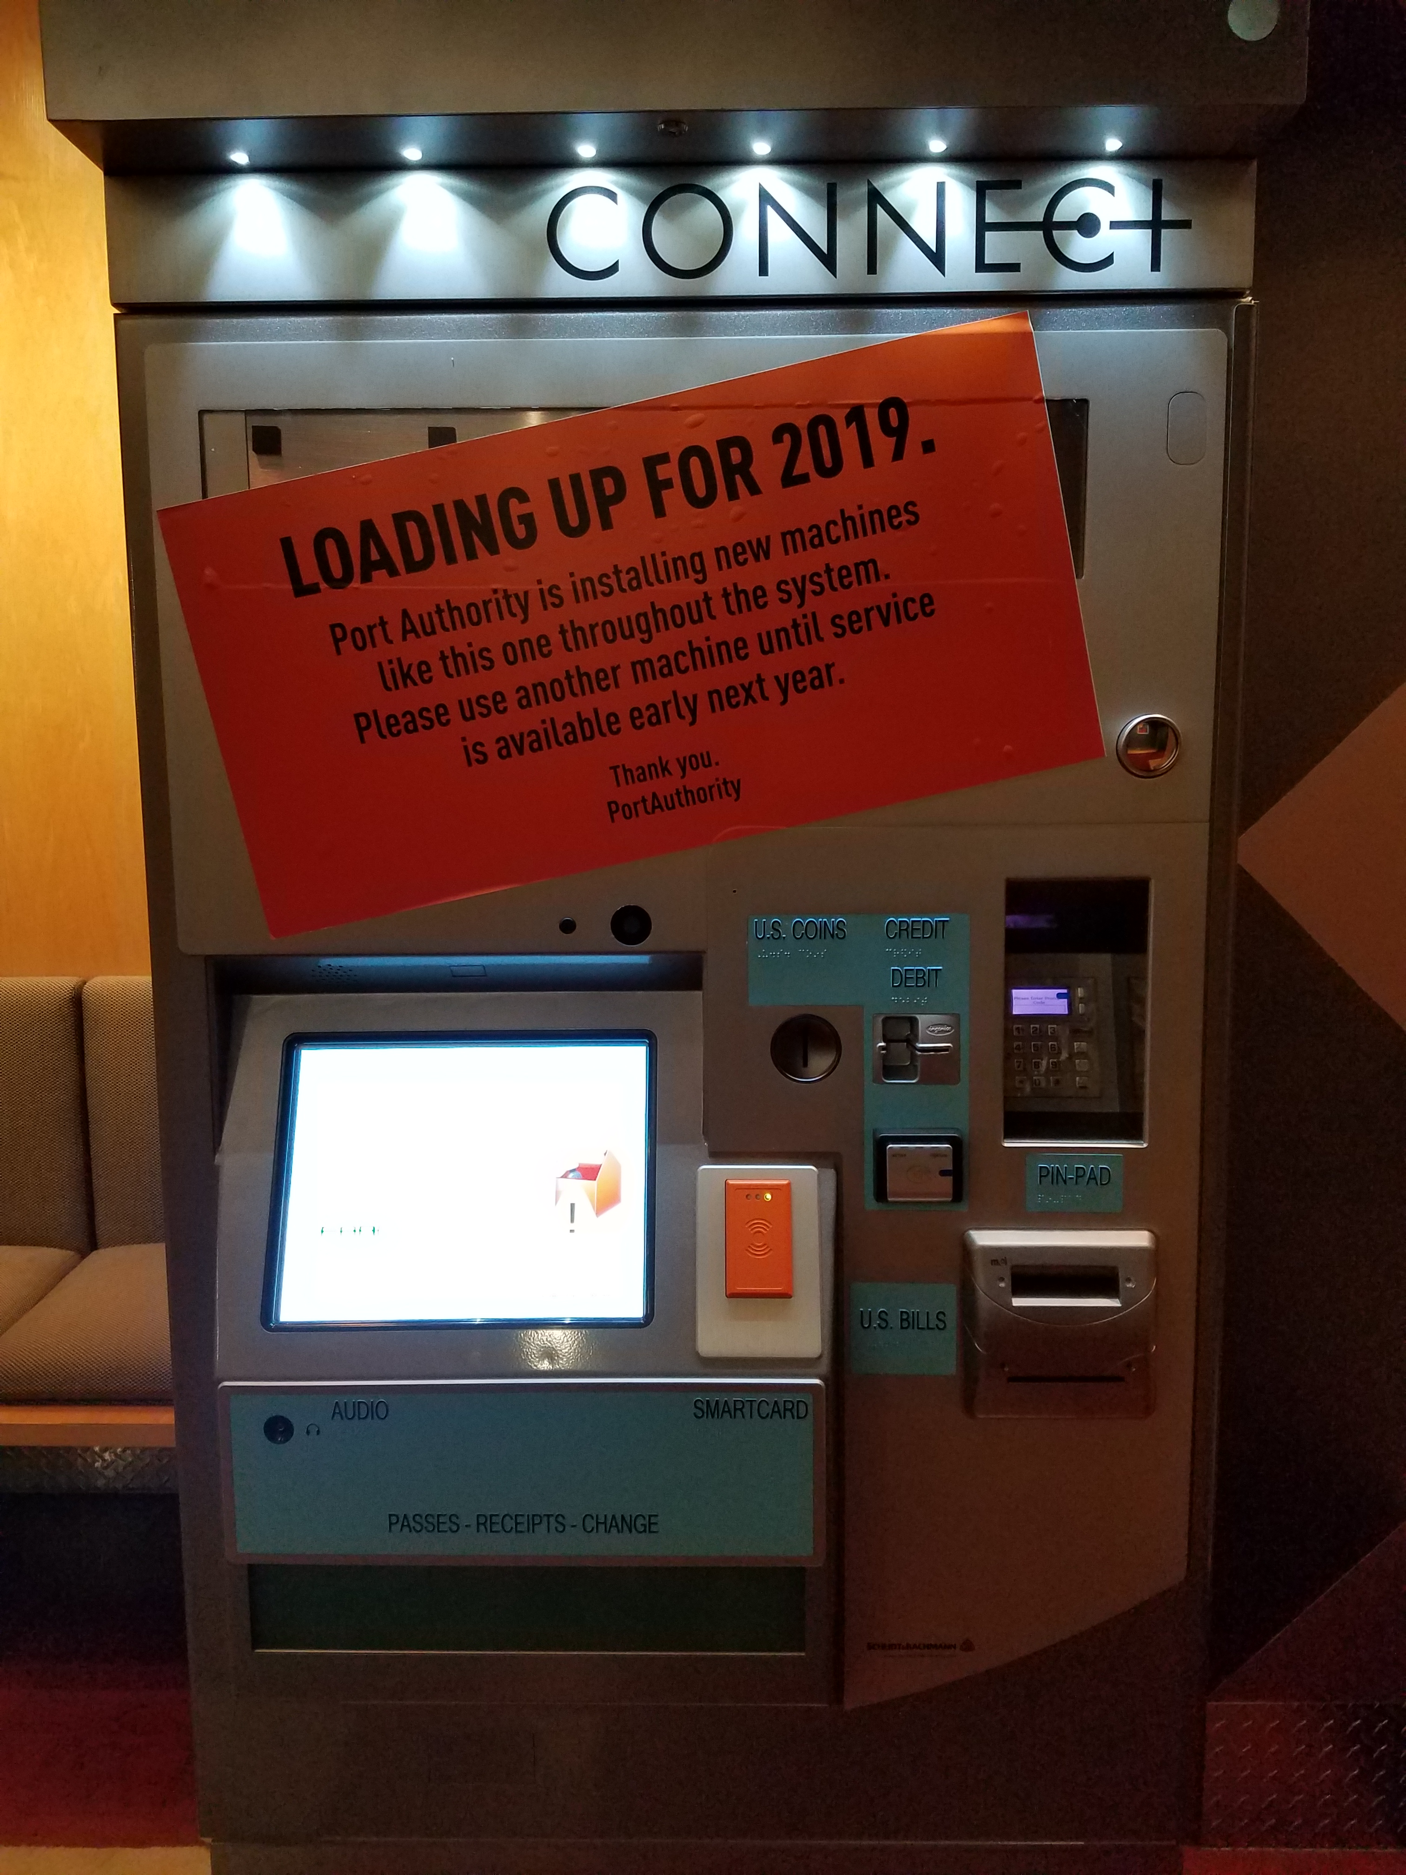
FY 2020 – December Financial Performance
Operating Income
Total Operating Income for the month of December was $497,290 above budget due to higher Passenger Revenue.
Total Operating Income through mid-year is $485,028 above budget due to higher Advertising Revenue and Interest Income.
Expenses
Total Expense for December was $314,008 under budget. The Authority did make a required $1.4 million dollar required catch-up payment to the ATU Pension Plan based on the recently completed actuarial report.
Total Expenses for the fiscal year are $17.1 million under budget. Other Expenses are $5.4 million under budget due in part to a $2.5 million Accident Recovery Credit settlement for the rail derailment.
  Materials & Supplies are $3.9 million under budget in part due to lower Material Expense.
  Purchased Services are $4.3 million under budget in part due to lower Work-Done-by-outside Contractor Expense
Subsidy
Total Subsidy for the month and fiscal year-to-date is ahead of plan, but this is strictly a timing issue that will normalize.
Finance Committee – January 2020

Slide 10
FY 2020 Fiscal Year over Fiscal Year Comparison
Total Operating Income is $61,329 higher than last fiscal year through December principally due to higher Interest Income.
Total Operating Expense is $649,777 higher than last fiscal year principally due to higher Employee Benefits.
  $2.784 million of Sick, Vacation and Holiday for salaried employees is categorized in Employee Benefits in FY2020 and was categorized in Salaries & Wages in FY2019 accentuating the negative variances in F2020.
Total Subsidy is $4.7 million lower than last fiscal year. This is due lower amounts of Preventive Maintenance dollars being utilized. The FY20 Budget is using $8.7 million less in Preventive Maintenance, so this result is expected.
Finance Committee – January 2020

Slide 11
Operating Reserves
FY 2020 - December, 2019
The Authority ended November 2019 with Operating Reserves of $149.7 million.
The Authority received approximately $40.8 million in cash deposits in December from Passenger Revenues and Operating Grants.
The Authority had cash outflows of approximately $43.9 million.
  This was slightly higher than past months due to 3 payrolls for employees on bi-weekly pays.
The Authority ended December 2019 with $146.6 million in Operating Reserves.
Finance Committee – January 2020

Slide 12
Mission
To Connect People to Life
Vision
To Become America’s Premier
Public Transportation Company

