Slide 1

Technology Committee
January 17, 2020
Our Mission: To Connect People to Life
Technology Committee – January 2020

Slide 2
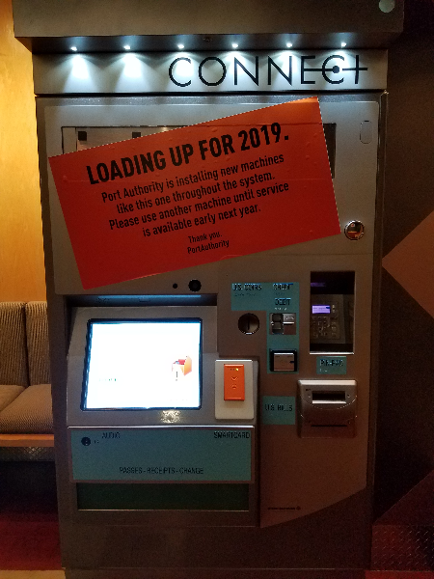
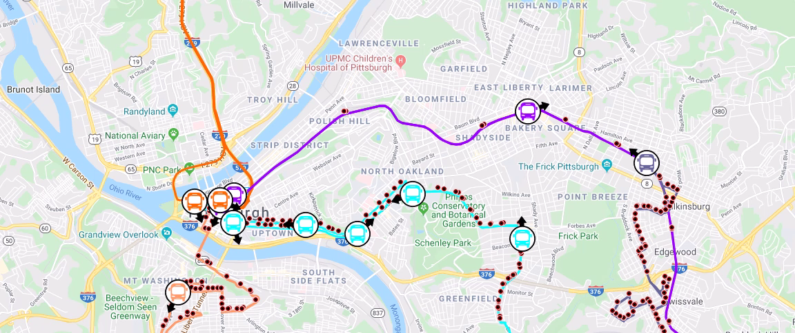
Resolution: Sole Source: Clever Devices
Disruption Management & IVN5 upgrade
Road closure
adjustments
Immediate
information
to customers
Upgrade legacy IVN3 devices to IVN5
truetime.portauthority.org
Technology Committee – January 2020

Slide 3
Open Data Initiative
Technology Committee – January 2020

Slide 4
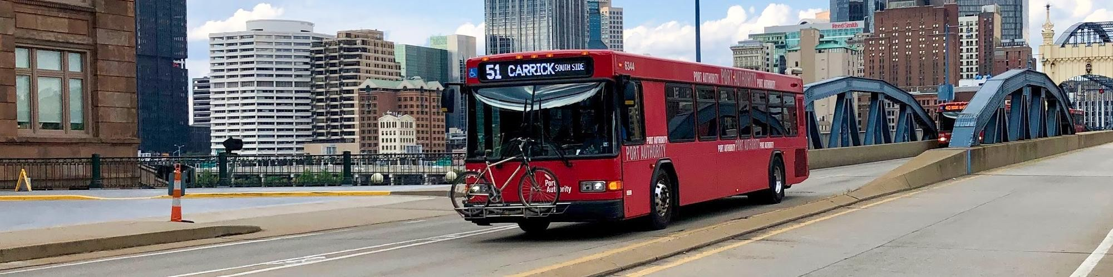
Open data
Data that anyone can access, use, and share.
Why publish data openly?
    Government data is owned by the public
    Empowers citizens, researchers, nonprofits, and businesses
    Reduce time spent answering ad-hoc requests

Slide 5
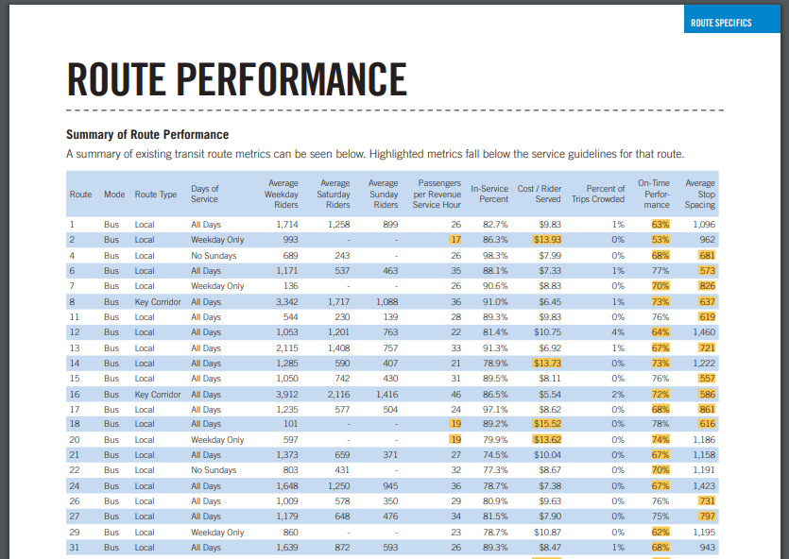
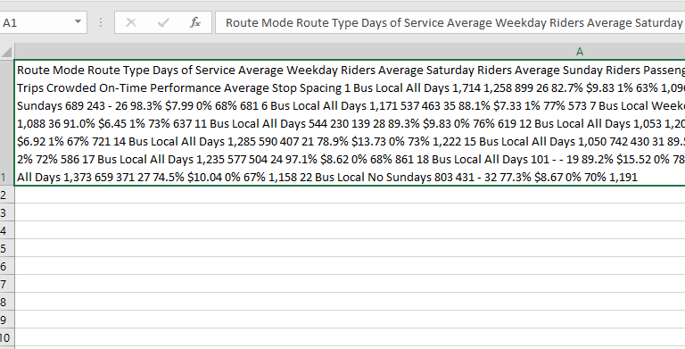
Question:
Is my bus getting more on time every year?

Slide 6
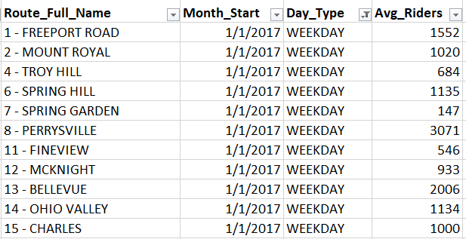
Partnership with the Regional Data Center
Added Data
Monthly ridership by route
Monthly OTP by route
Scheduled trip counts
Bus stop usage
Expanded GIS data
5
new datasets added
6+
Ad-hoc data requests prevented
wprdc.org

Slide 7
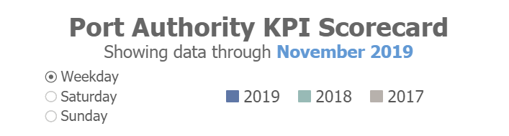
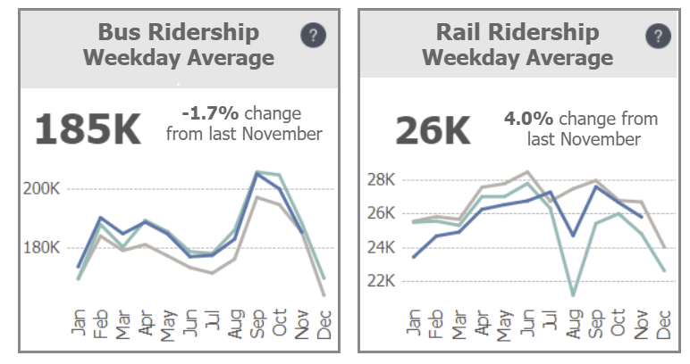
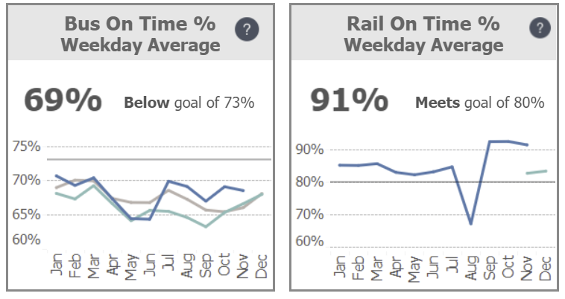
portauthority.org/opendata

Slide 8
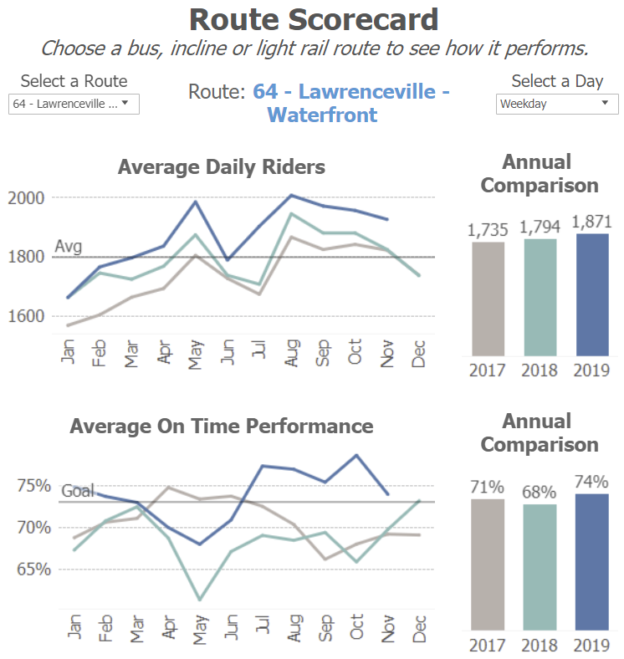
760+
views so far
portauthority.org/opendata

Slide 9
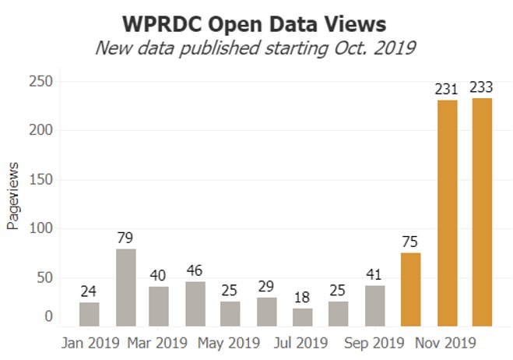
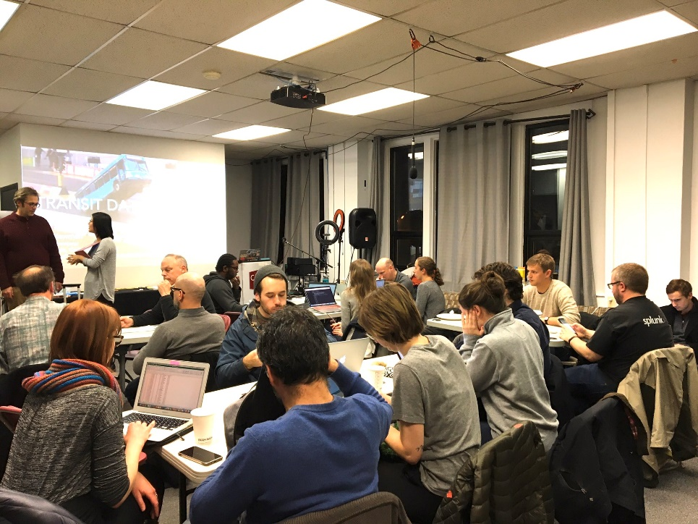
Community response
400%
30+
attendees at open data event
increase in open data pageviews

Slide 10
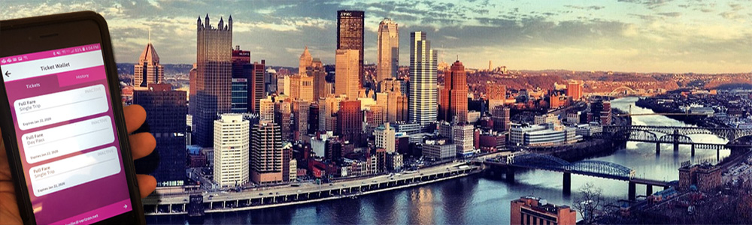
Mobile Ticketing App
Technology Committee – January 2020

Slide 11
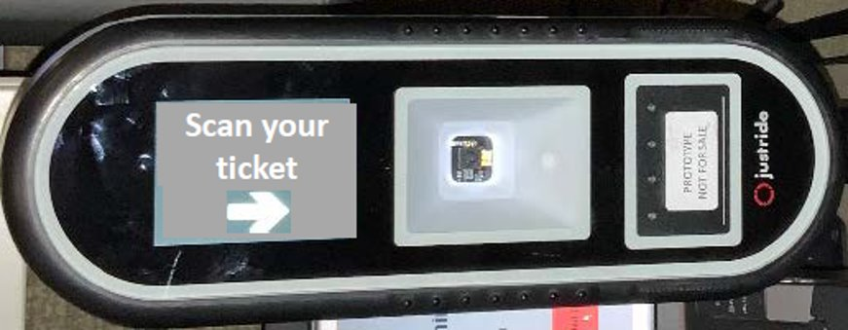
Progress! Mobile Ticketing App
Mobile Ticketing App now being tested
Testing of validators to begin in February
50 validators being installed on buses starting Monday, 1/20/2020.
Technology Committee – January 2020

Slide 12

Mission
To Connect People to Life
Vision
To Become America’s Premier
Public Transportation Company

Slide 13
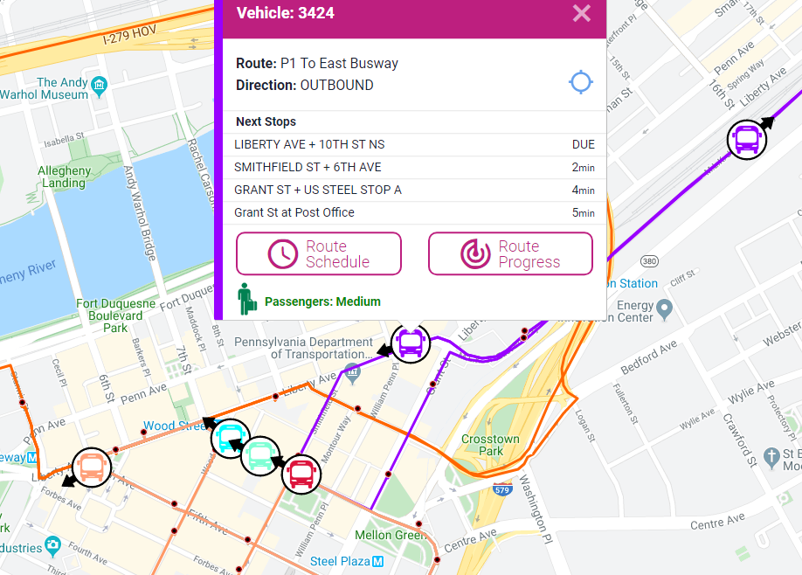
Mission
To Connect People to Life
Vision
To Become America’s Premier
Public Transportation Company

